Slide 1

Project (Part-2) presentation on
Hospital Management System
Prepared and Presented By:-
Group 1,ECE 4th year of Techno Engineering College, Banipur
Sourav Paul | 24400317010
Anushka Dey | 24400317047
Sourav Roy | 24400317009
Surya Das | 24400317006
UNDER GUIDANCE OF:
Mrs. Roshni Chakrabarti, Asst. Prof. of ECE dept of Techno Engineering College Banipur
Date-26/06/2021
Time-10:30am

Slide 2
Contents:
1. | Introduction…………………………………………………………… | 1
2. | Objective……………………………………………………………….. | 2
3. | Flowchart………………………………………………………………. | 3
4. | Technologies…………………………………………………………. | 4
5. | Process…………………………………………………………………. | 5
6. | Features………………………………………………………………... | 9
7. | Output…………………………………………………………………… | 10
8. | System Requirements…………………………………………….. | 11
9. | Conclusions…………………………………………………………… | 12
10. | Future Plan……………………………………………………………. | 13
11. | References…………………………………………………………..... | 14

Slide 3

INTRODUCTION:
1
An automated and integrated software for all hospital needs.
Used in hospital, clinic for maintaining general patient details.
Paper less office and transmit data within the departments.

Slide 4
OBJECTIVE:
2
Computerize the front office management of hospital to develop software which is user friendly simple, fast and cost – effective.
Based on database and object oriented programming.

Slide 5
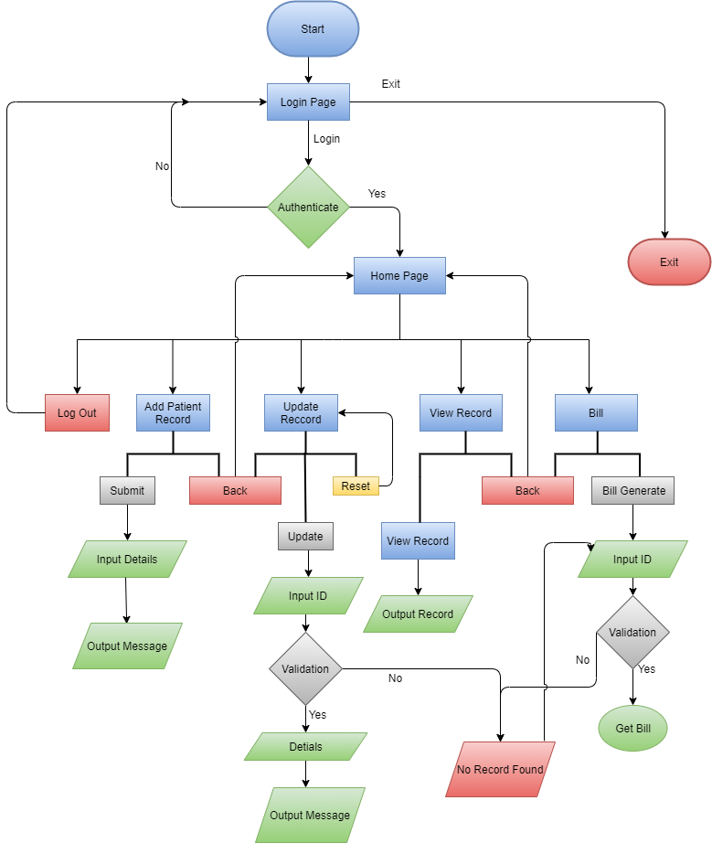
Flowchart:
3
Flowchart -1:Base Flowchart

Slide 6







Technologies:
4
Java 8
Java 8
Java Swing
MySQL
Java Database Connectivity (JDBC)
Eclipse IDE
Eclipse Plugin (Window Builder)
Launch4j
MySQL
JDBC
IDE
Java Swing
Window Builder
Launch4j

Slide 7

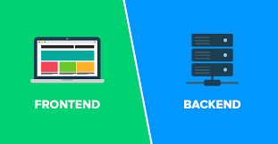
Process:
5
Total implementation of this project requires 3 steps:
Front End Implementation
Back End Implementation
Data Base Creation

Slide 8

Front End Implement:
6
Java Swing and Java Applet.
Java Swing package was used.
Java Swing is preferrable for Window Based application.
Drag and drop technique used.
It reduces the chance of any error in code.
Window Builder Plug of eclipse IDE.

Slide 9

Back End Implement:
7
Java 8,JDBC was used.
Total 7 classes.
ConnectionProvider()
LoginScreen()
HomeScreen()
AddNewRecord()
UpdateRecord()
GetBill()
ViewRecord()

Slide 10


Databases:
8
There are 3 tables in databases :
i. Patient table
ii.User_Credentials Table
iii.Diagnosis_Fees Table
Table: Patient
Table: User_Credentials
Table: Diagnosis_Fees
Columns:
ID varchar (10)
PK
Name varchar (20)
Age varchar (3)
Address varchar (1000)
Mobile No varchar (10)
Date varchar (10)
Major Illness varchar (50)
Email ID varchar (50)
Gender varchar (6)
Blood Group varchar (4)
Diagnosis varchar (10)
Columns:
Name varchar (20)
Username varchar (15)
PK
Password varchar (15)
Columns:
Diagnosis varchar (10)
PK
Fees varchar (100)

Slide 11





Features:
9
Add Record:
Generates auto ID to avoid duplicate data.
Insert the given data of patient into the database
Bill:
Extract record from database.
Generate bill based on Diagnosis.
Login:
Prevents unwanted person to access the application. Only the authenticated person can access whole features.
Update:
Extract record from database.
Correct existing record and update it in database.
View Records:
Display all Records.
Display a particular record based on customizable search.

Slide 12
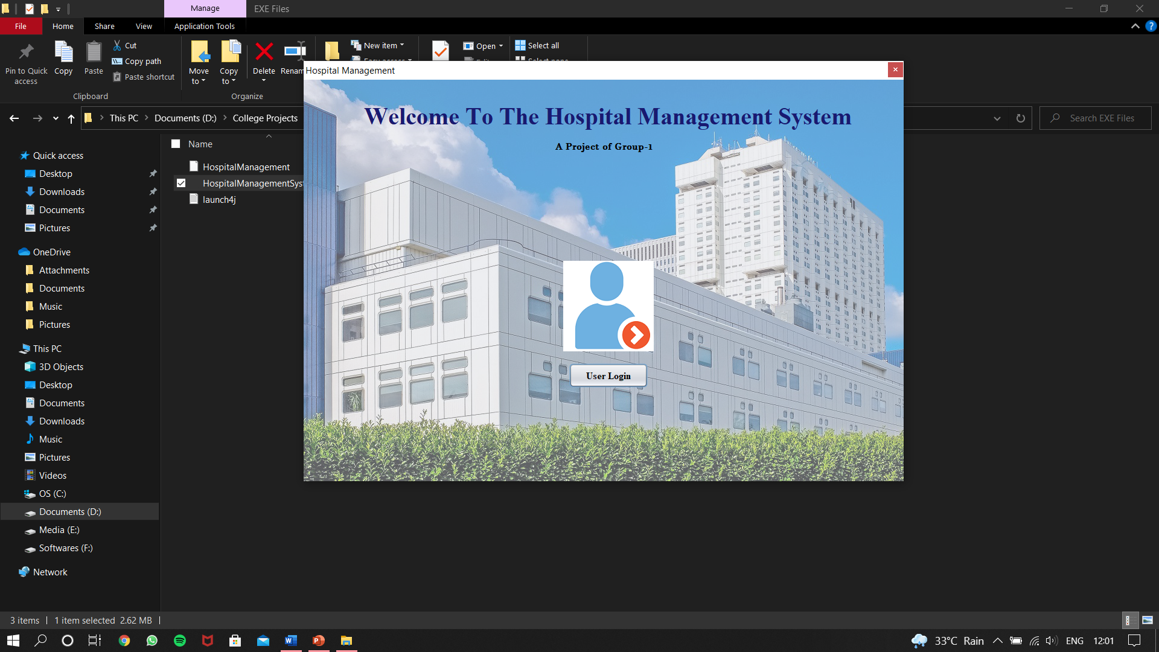
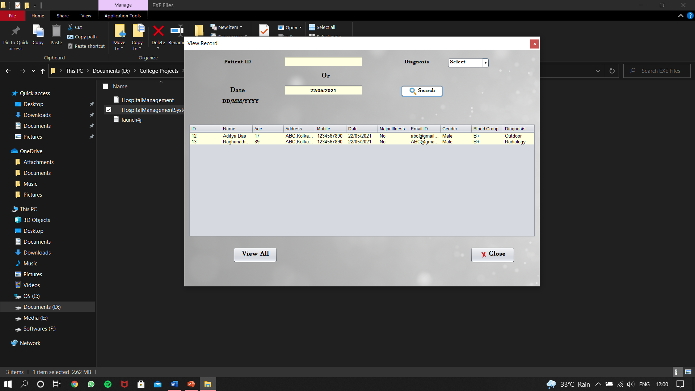
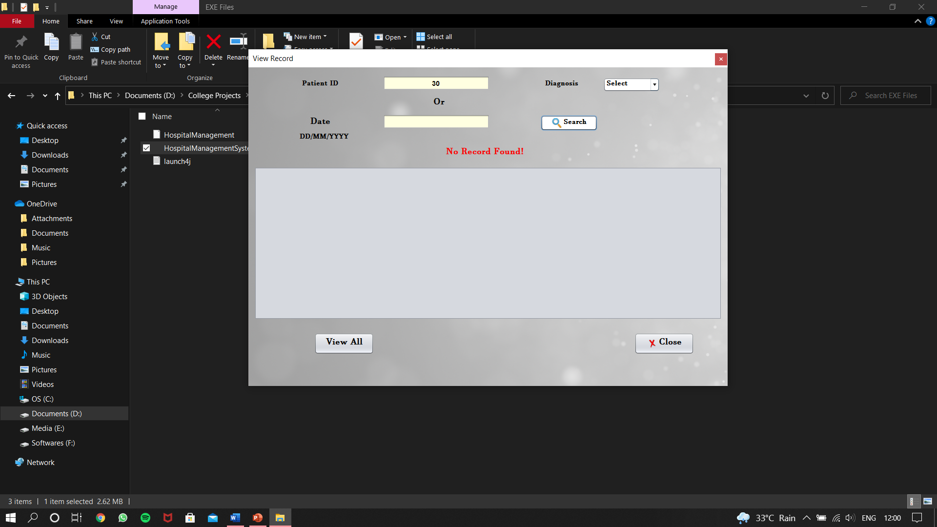
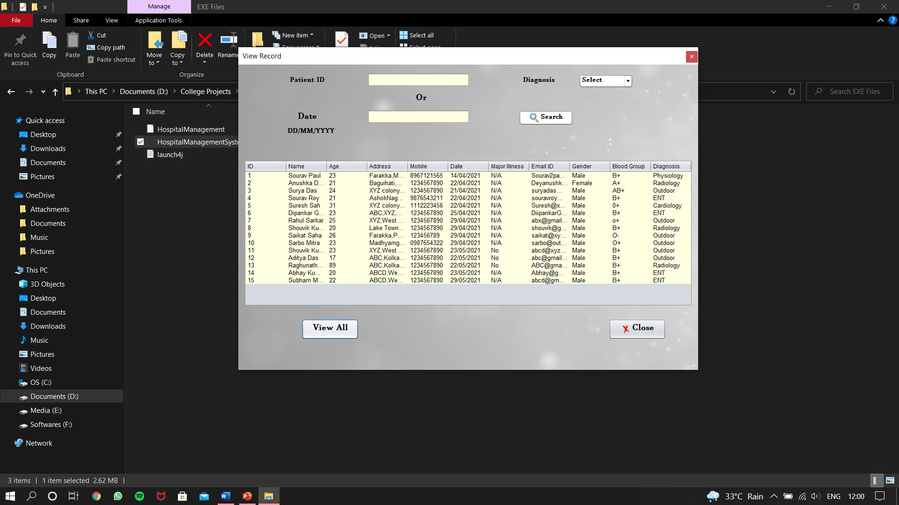
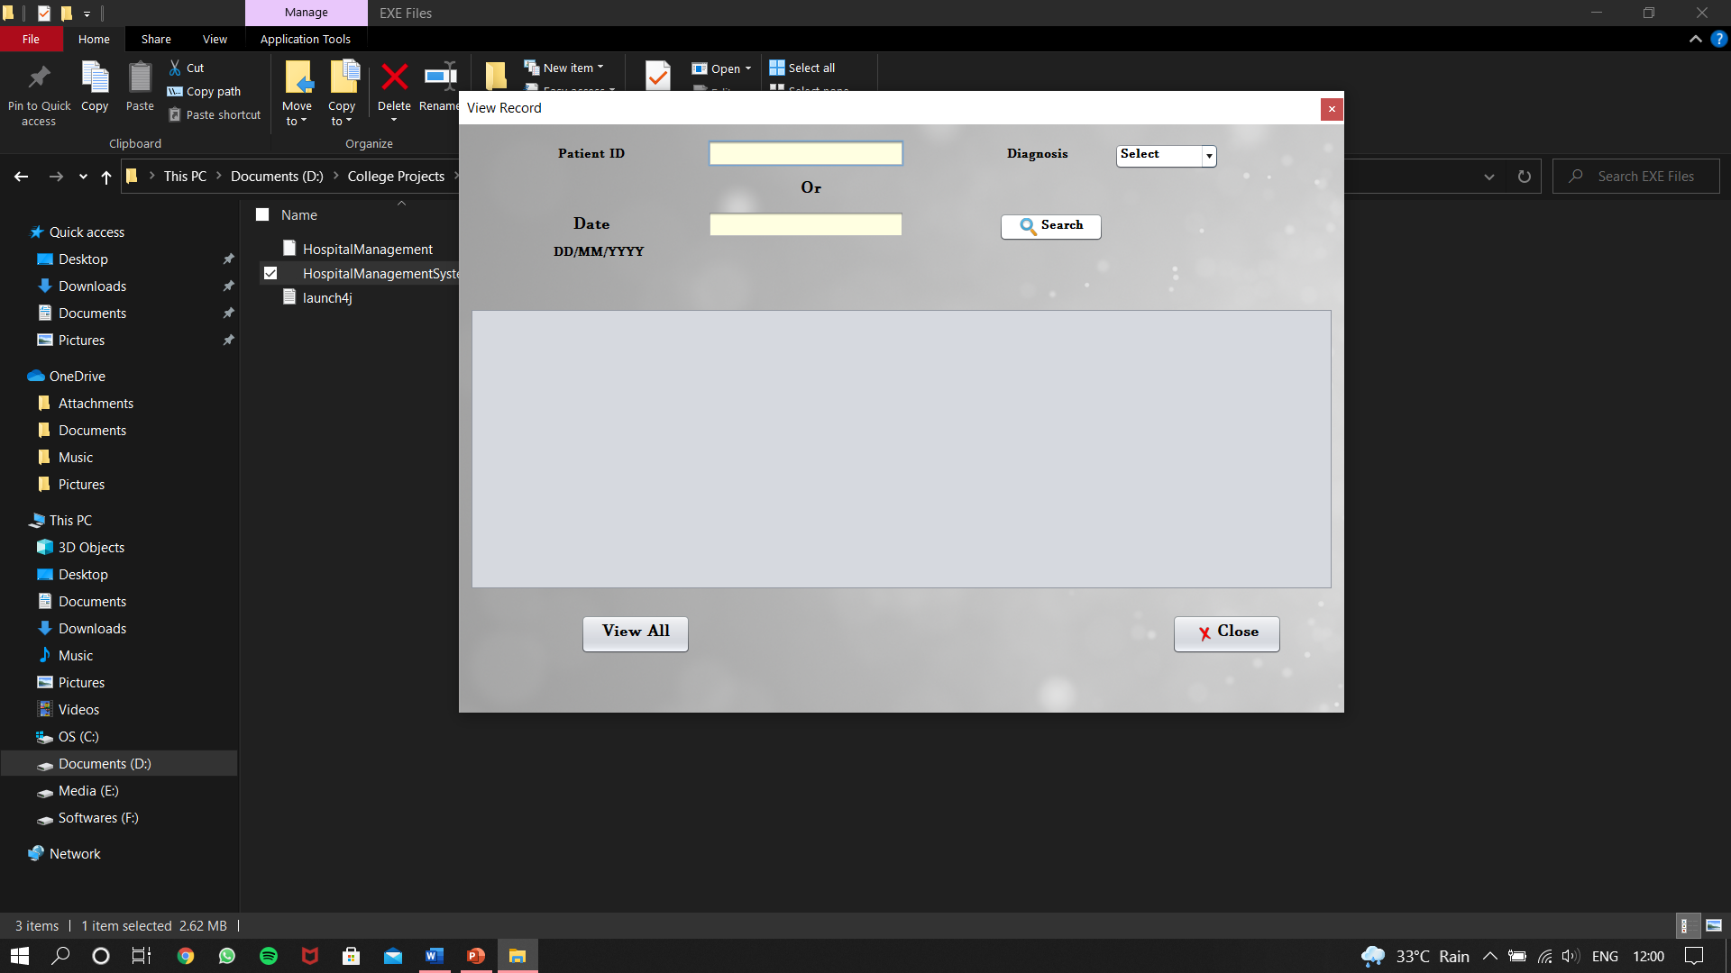
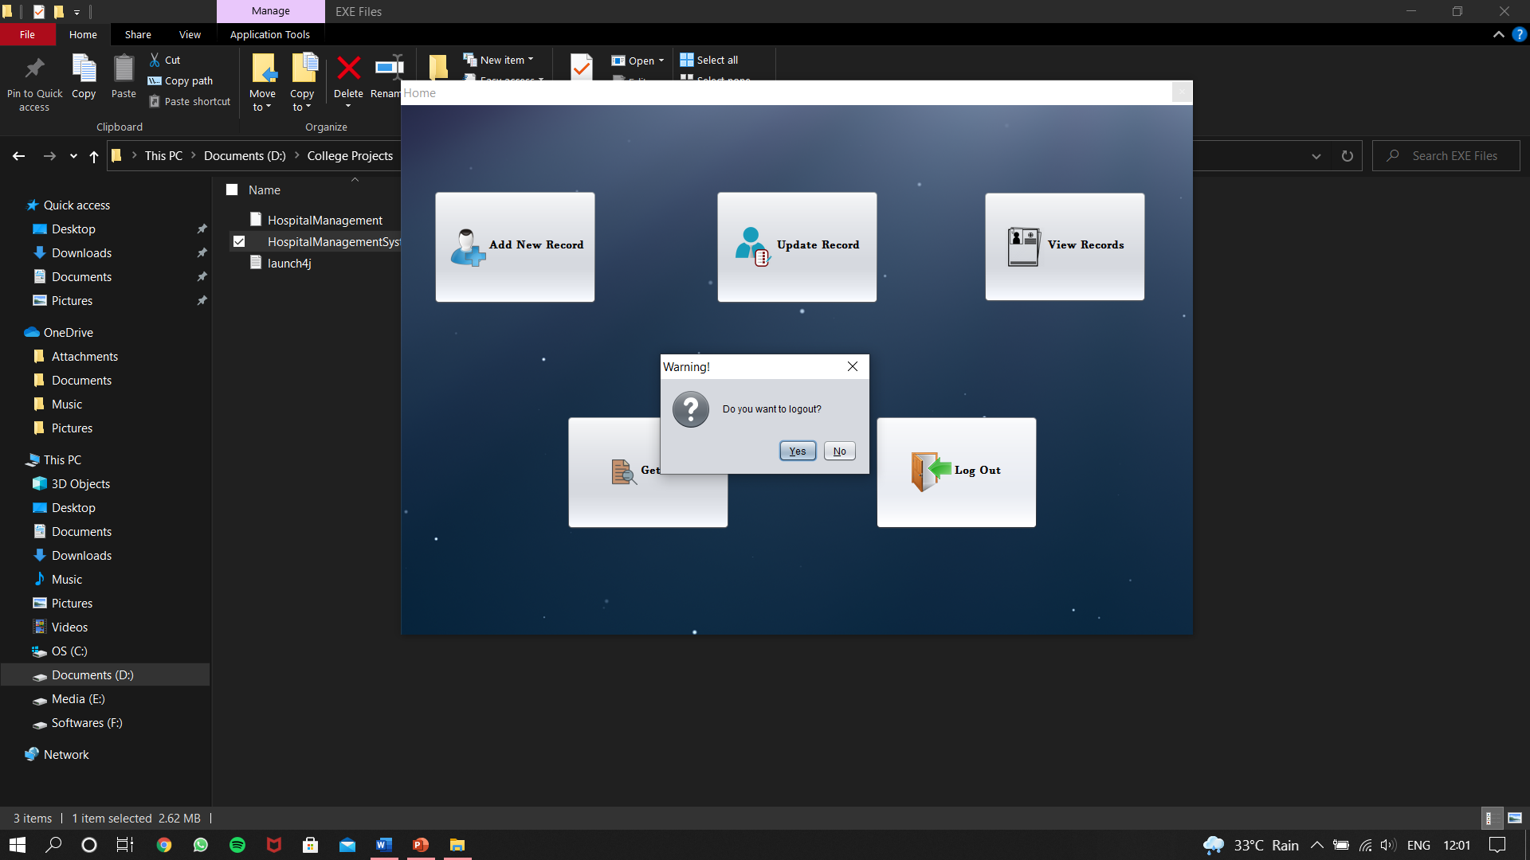
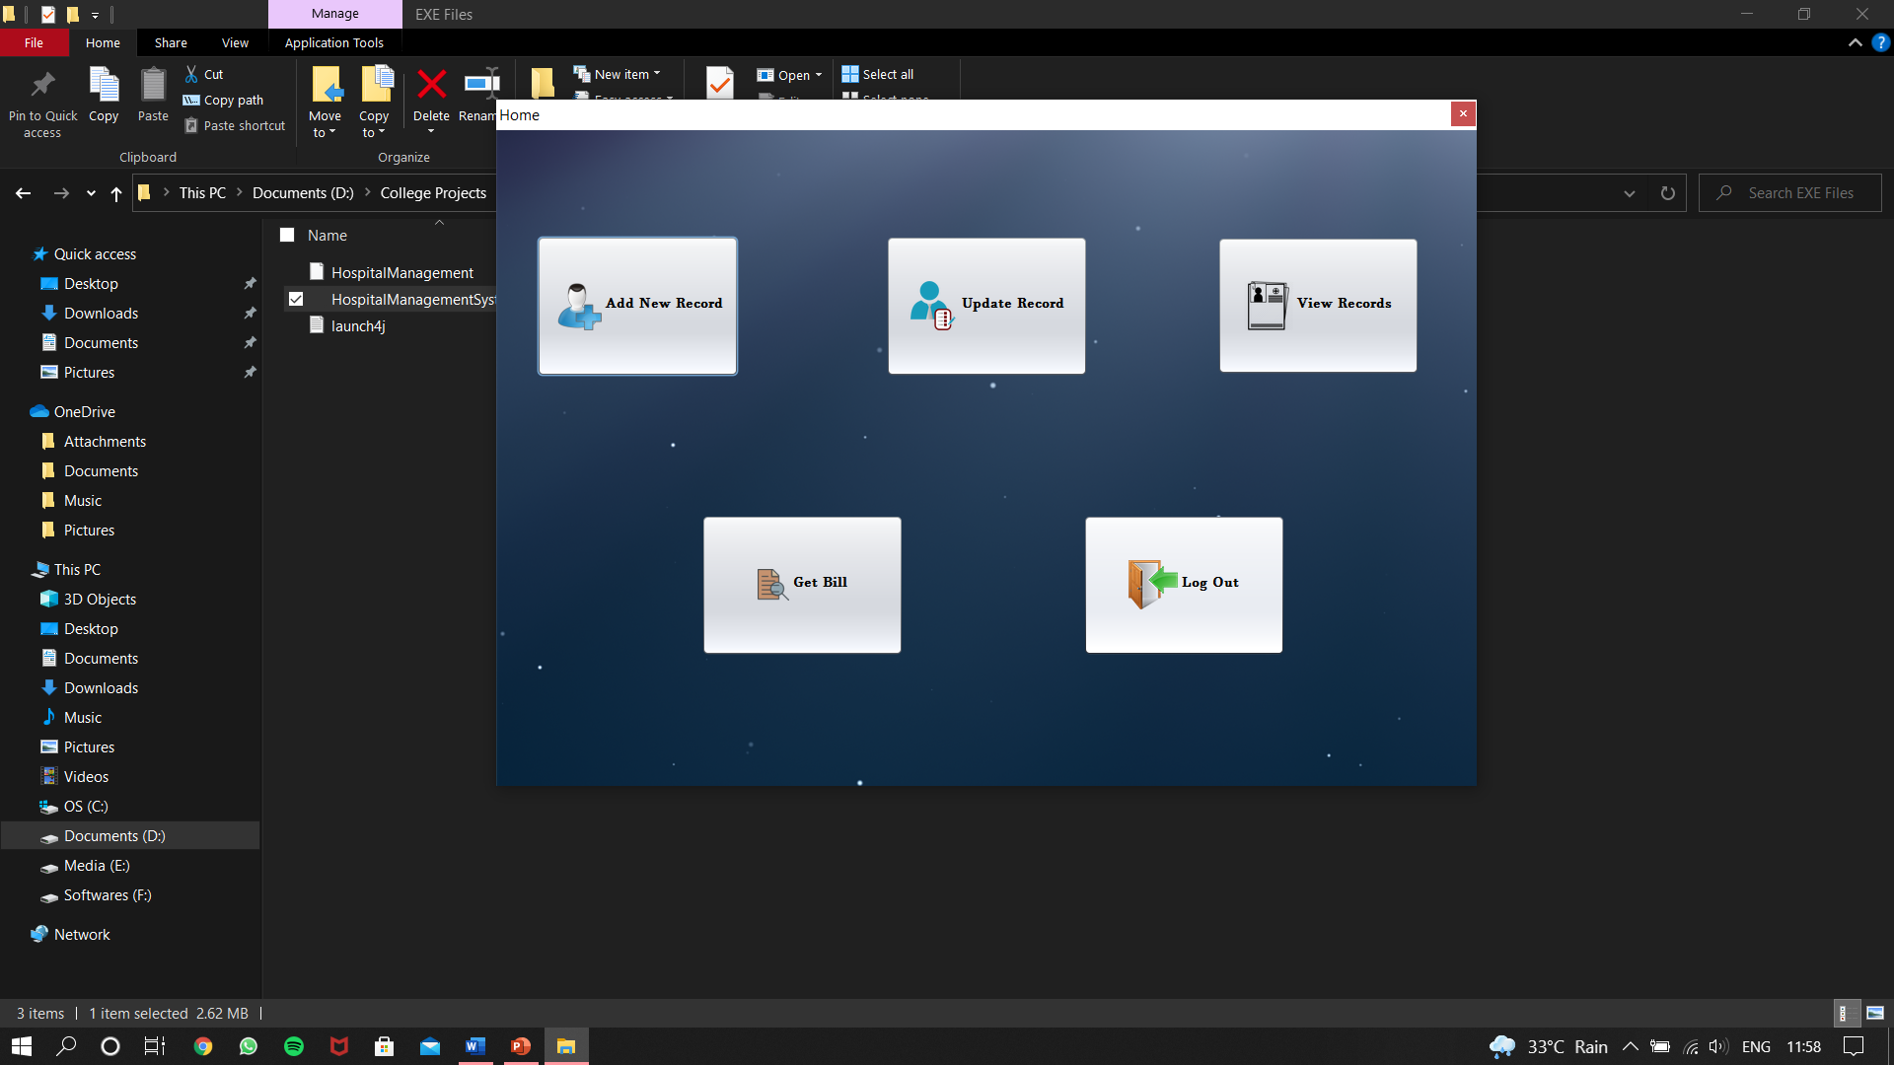
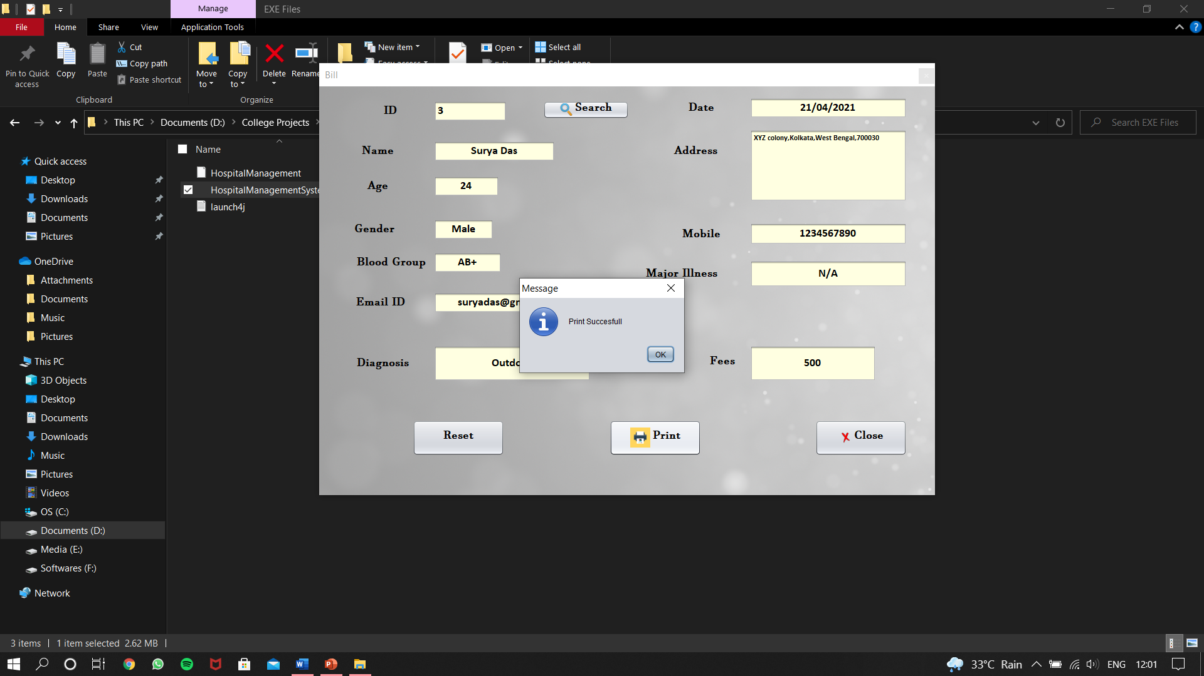
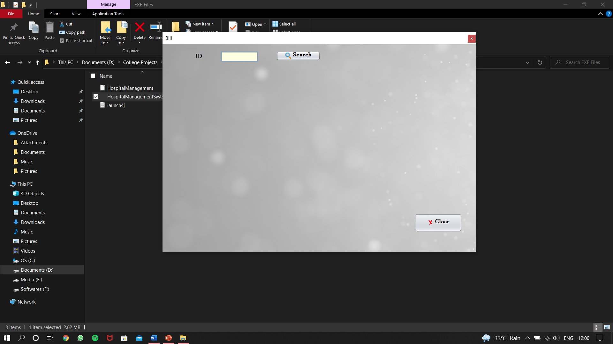
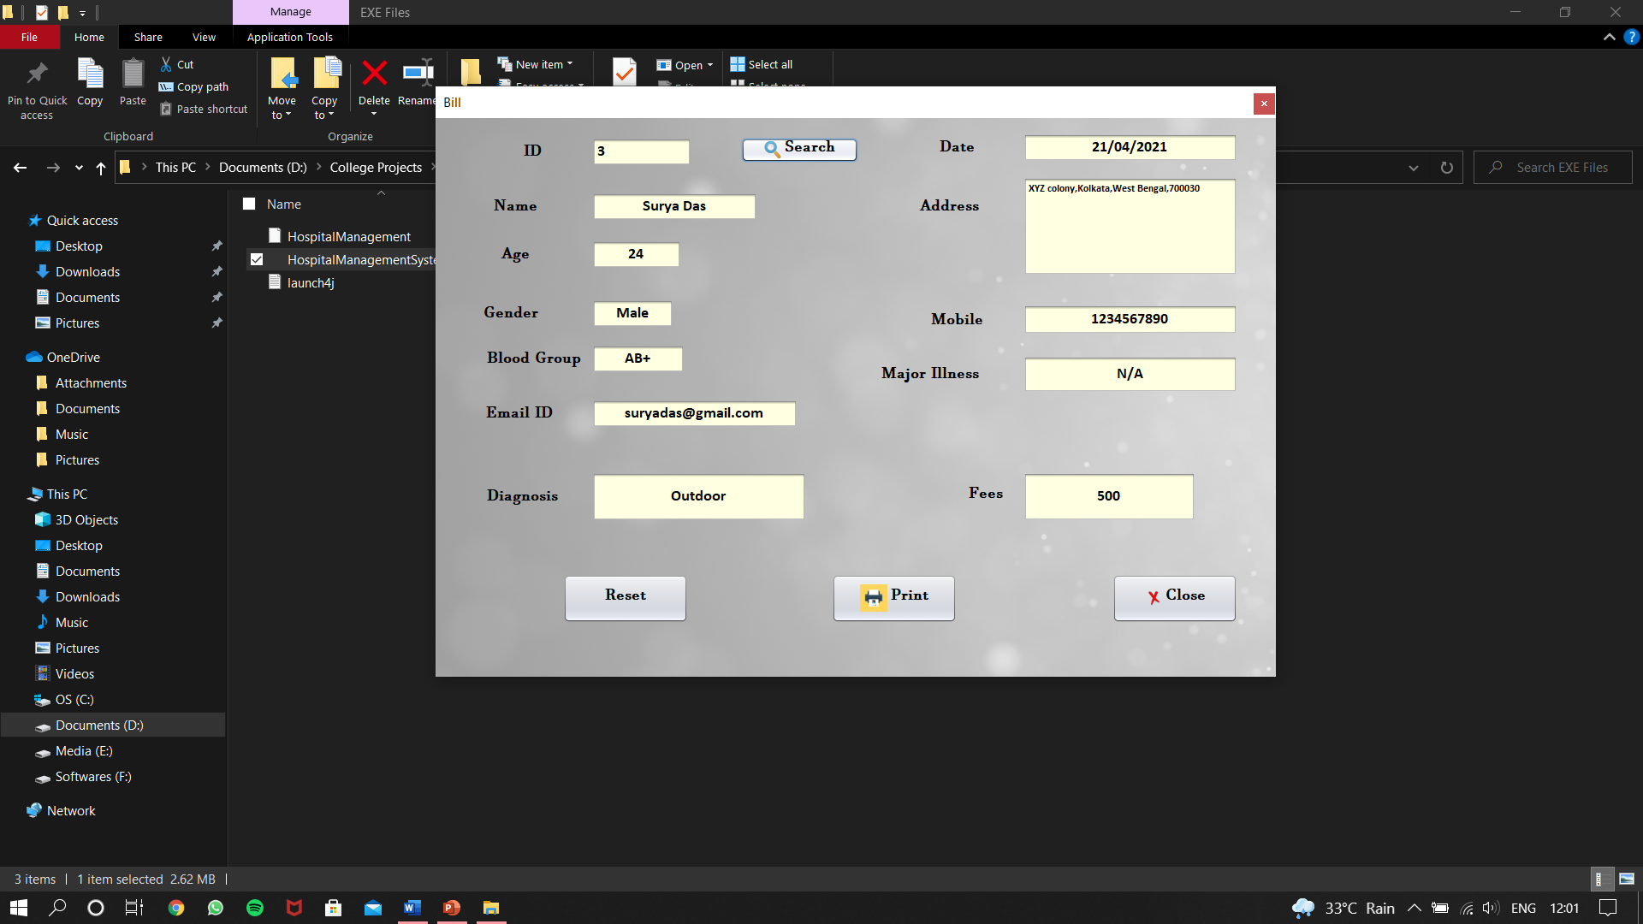
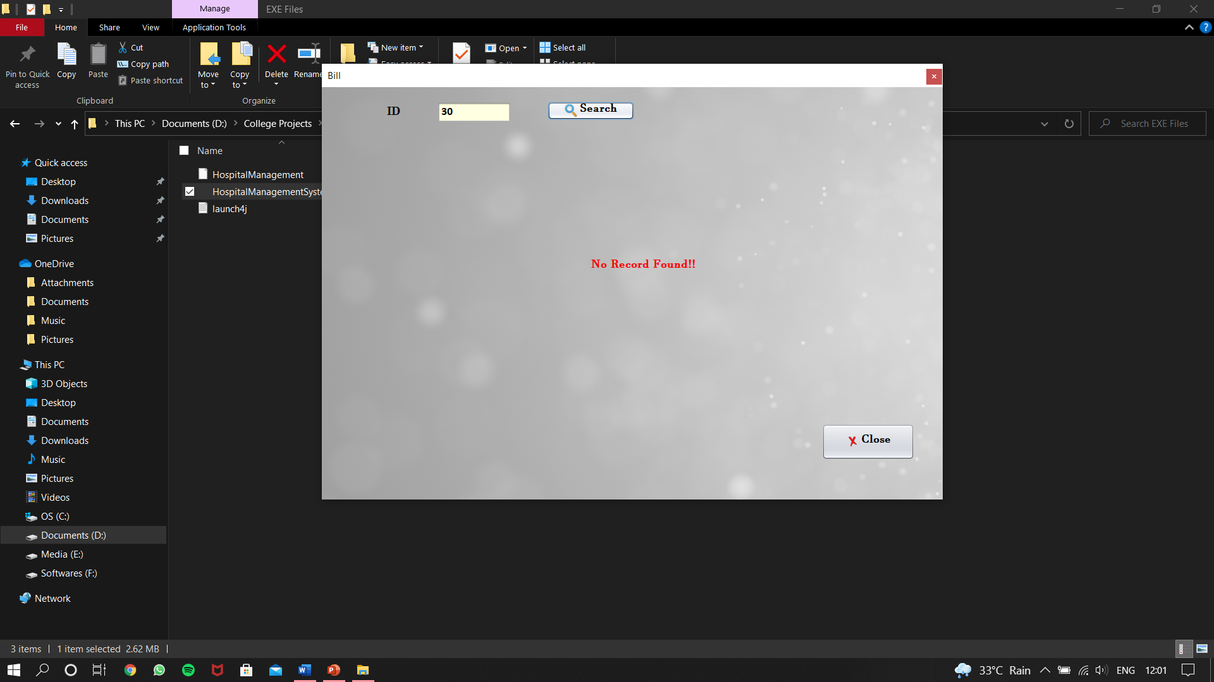
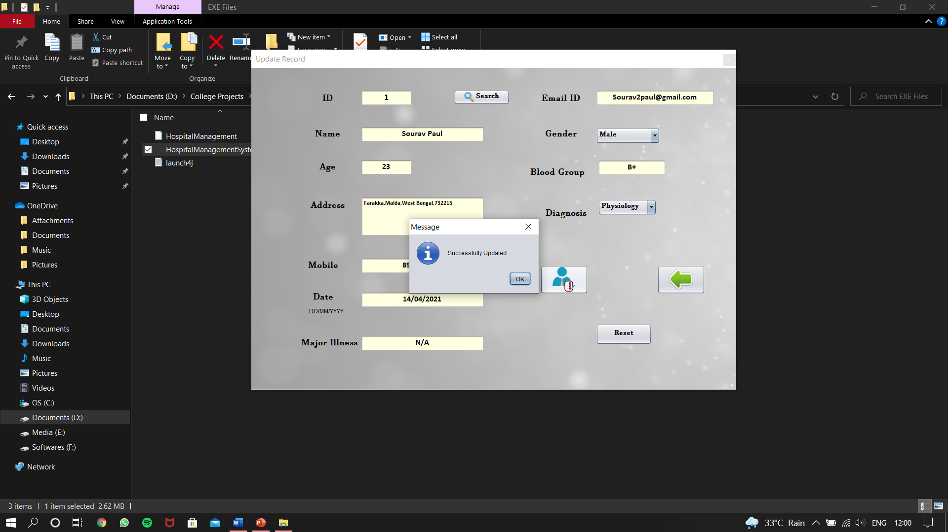
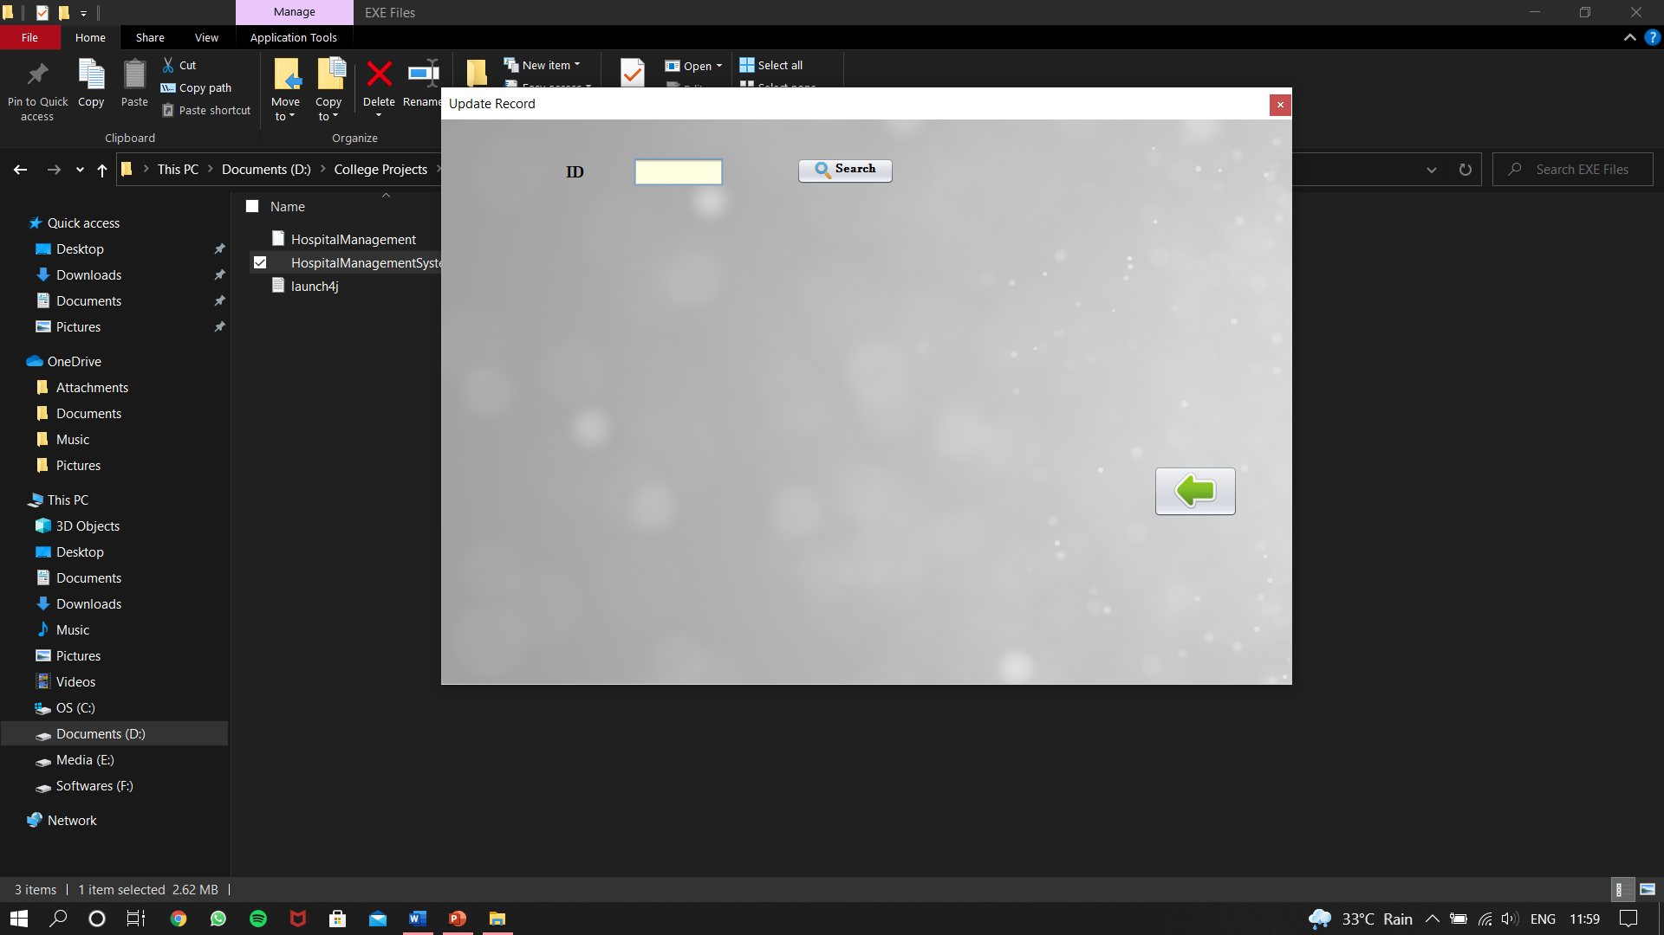
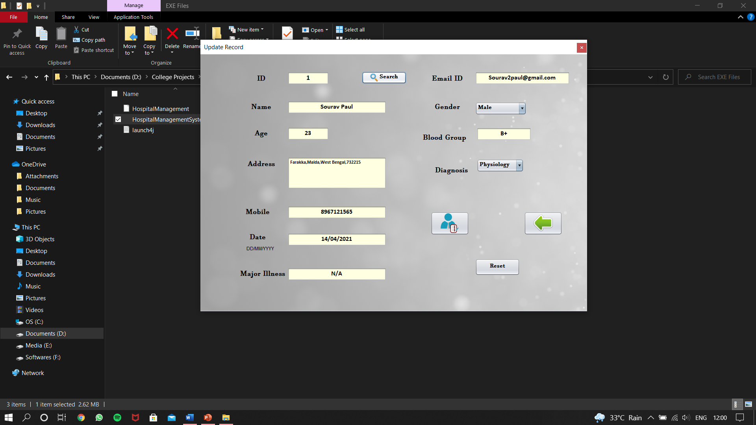
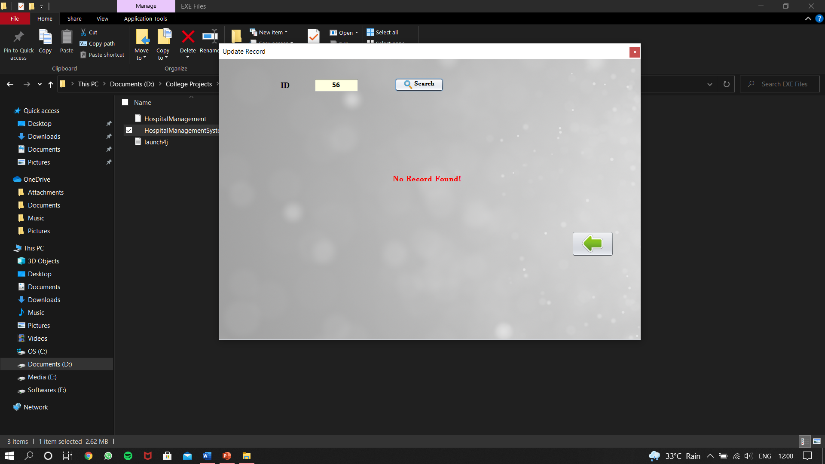

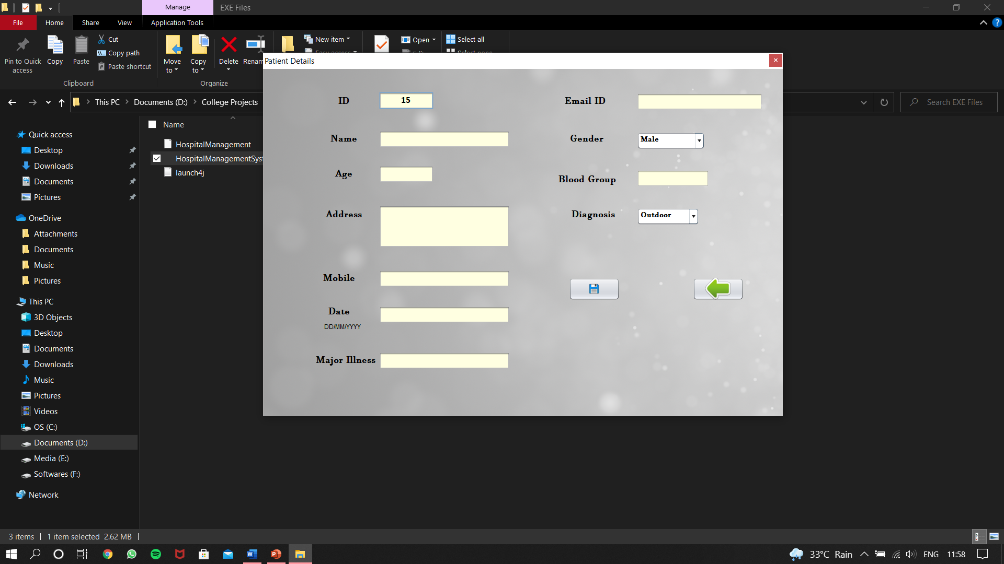
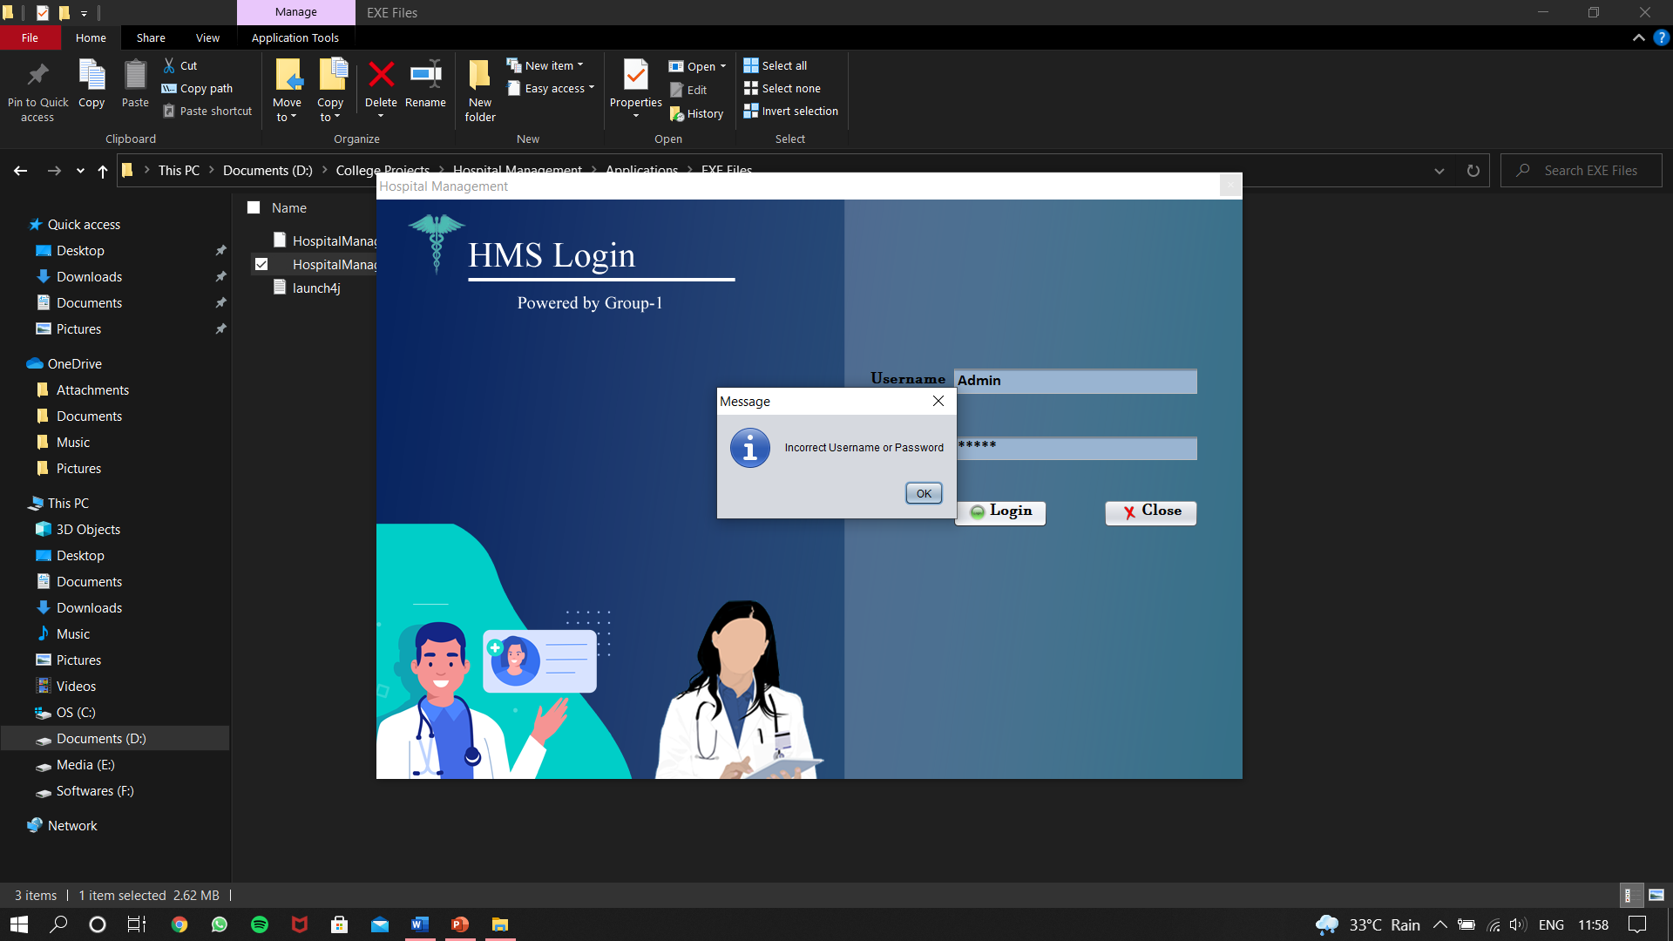
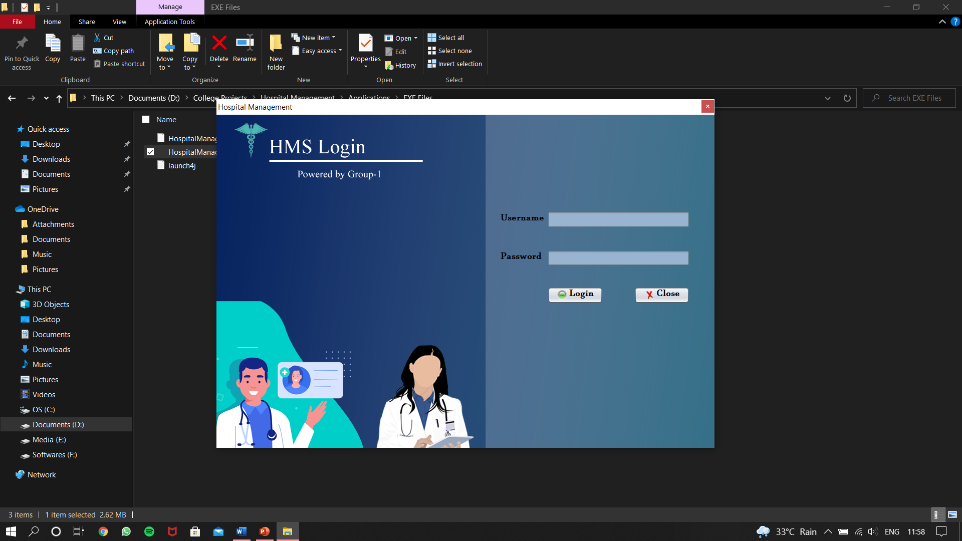
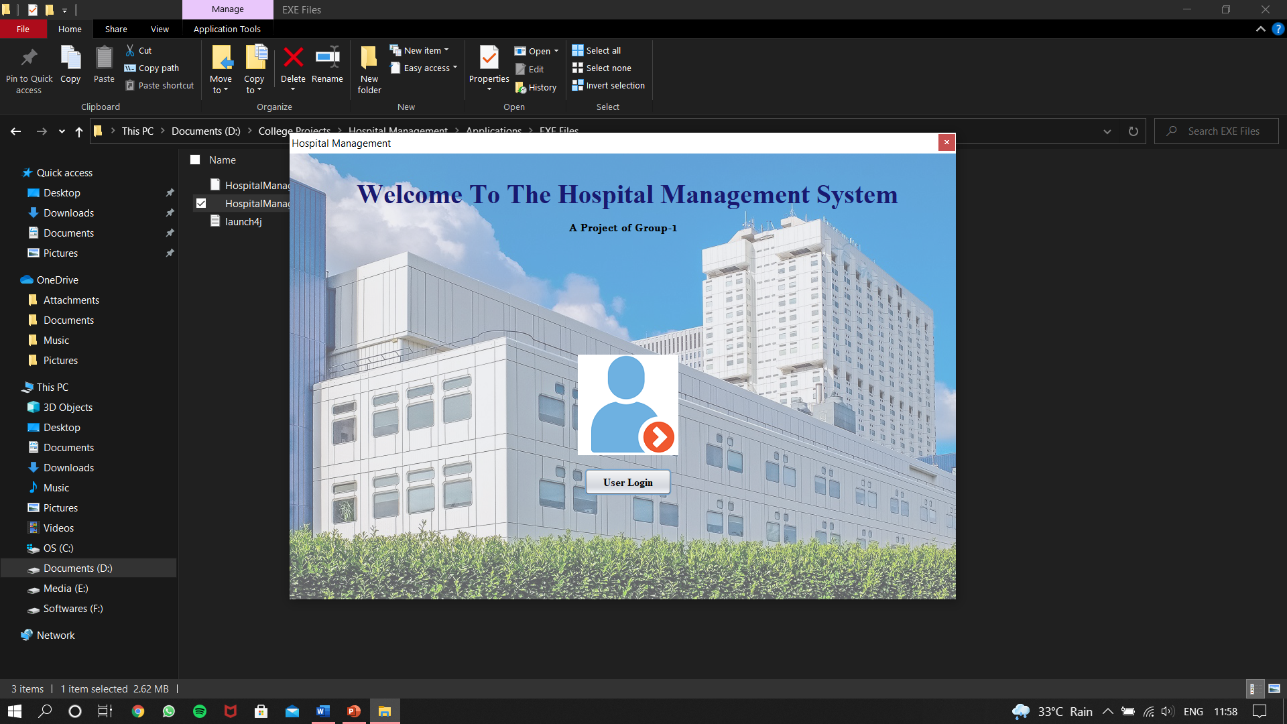
Output:
10

Slide 13

System Requirement:
11
Space required maximum 10mb.
Light weight stand alone software for low end PC.
Minimum requirements Processor Pentium ,2gb RAM ,Windows 7-64bit, Intel HD graphics according to test.
Recommended requirements Processor Intel i3 or AMD A6 ,4gb RAM ,Windows 8 -64bit and higher.

Slide 14
Conclusions:
12
The project Hospital Management System (HMS) is for computerizing the working in a hospital.
Overall the project teaches us the essential skills like:
Gained an insight into the working of the HOSPITAL.
Using drag and drop design techniques.
Understanding the database handling and query processing.
Creates a strong sense of time management.
Sense of teamwork.

Slide 15
Future Plan:
13
More diagnosis options.
Features like Doctor list, Doctor appointment for patient end.
Pharmaceutical details for Pharmacy department.
More features for different hospital department.
Optimization using other technologies.
Visual improvement.

Slide 16

References:
14
Java: The Complete Reference by Herbert Schildt.
Abraham Silber Schatz, Henry F. Korth and S. Sudarshan “Sixth Edition Database System Concepts released
MySQL/PHP Database Applications, 2nd Edition by Brad Bulger
BinStock, Andrew (May 10,2015) “Java’s 20 years of Innovation”. Forbes. Archieved from the original on March 14,2016. Retrieved March 18, 2016
Ali Bahrami, “Object Oriented System Development, 3rd Edition Tata McGraw Hill Edition”.
Elmarsi and Navathe, “Fundamentals of Database System, Third Edition”, Addision Wesley.
Gosling, James; Joy, Bill; Steele, Guy; Bracha, Gilad; “The Java Language Specification, 2nd Edition”. Archieved from the original on August 5, 2011. Retrieved February 8, 2008.
Walter Shields, “Guide: The Simplified Beginner’s Guide to SQL”.
Brain Martin, “JDBC Developer Guide and References, 10g Release 2”.
Kathy sierra and Bert Bates, “Head First Java, 2nd Edition”.

Slide 17


